Slide 1

Credit Card Defaulter Prediction
https://www.kaggle.com/datasets/gauravtopre/credit-card-defaulter-prediction​

Slide 2
INTRODUCTION
Problem Statement
Back in 2006, Taiwan's credit card industry had a big problem. They were giving out too many credit cards to people who shouldn't have gotten them, and people were using these cards without thinking about whether they could pay back the money. This led to a lot of debt on these cards and made people really worried about their money. Both the banks and the people with the cards were facing a tough situation.
Data Dictionary
LIMIT_BAL : maximum amount of money that the cardholder is allowed to borrow from the credit card issuer.
PAY_1, PAY_2, PAY_3, PAY_4, PAY_5, PAY_6: These show whether a person paid their credit card bill on time. The numbers represent different levels of delay in payments.
BILL_AMT1, BILL_AMT2, BILL_AMT3, BILL_AMT4, BILL_AMT5, BILL_AMT6: These tell us how much money a person owed on their credit card in different months.
PAY_AMT1, PAY_AMT2, PAY_AMT3, PAY_AMT4, PAY_AMT5, PAY_AMT6: These show how much money a person paid on their credit card bill in different months before the current one.
In short, these columns give us information about when payments were made, how much money was owed on the credit card, and how much was paid in previous months.

Slide 3
PROJECT ROADMAP
EDA and Data Preparation | Model Building | Evaluation Metrics | Model tuning and Conclusion
Datatypes Null values Outliers Features and Target Data Scaling Label Encoding Boxplot Scatterplot | Logistic Regression Decision Trees Random Forests | Accuracy score Confusion matrix Precision Recall F1 score | GridSearchCV Comparison of different algorithms' performances

Slide 4
EDA and Data Preparation
1. Shape of Data | df.shape | a.Examples = 30000 b. Features = 24
2. Label Encoding | from sklearn.preprocessing import LabelEncoder encoder = LabelEncoder() df['default '] = encoder.fit_transform(df['default ']) | Non defaulter coded as 0 Defaulter coded as 1
3.Number of Classes | df['default '].value_counts() | 0 23364 1 6636
4. Split features and target | feature_df = df.drop(['default '], axis=1) target_df = df['default '] | (30000, 24) (30000,)
5.Seperate Numerical and categorical features | num_features = feature_df[['LIMIT_BAL','AGE', 'PAY_0', 'PAY_2', 'PAY_3', 'PAY_4', 'PAY_5', 'PAY_6', 'BILL_AMT1', 'BILL_AMT2', 'BILL_AMT3', 'BILL_AMT4', 'BILL_AMT5', 'BILL_AMT6', 'PAY_AMT1', 'PAY_AMT2', 'PAY_AMT3', 'PAY_AMT4', 'PAY_AMT5', 'PAY_AMT6']] cat_features = feature_df[['SEX', 'EDUCATION', 'MARRIAGE']]

Slide 5
6. Scale the numeric features | from sklearn.preprocessing import StandardScaler scaler = StandardScaler() num_features = scaler.fit_transform(num_features) | Scaled numerical features
7. One Hot Encoding of Categorical Features | cat_features_df = pd.get_dummies(cat_features) | One hot encoded categorical features
8.Combine numerical and categorical features to build model | features_df = pd.concat([num_features_df, cat_features_df], axis=1) | Features_df(30000,32)
9.Split data into train and test | from sklearn.model_selection import train_test_split x_train, x_test, y_train, y_test = train_test_split(features_df, target_df, train_size=0.8) | x_train.shape(24000, 32), x_test.shape(6000, 32), y_train.shape(24000,), y_test.shape(6000,)

Slide 6
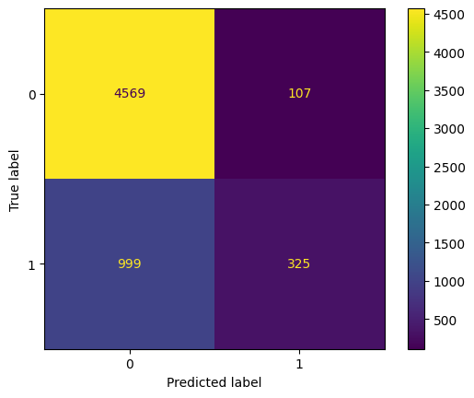
LOGISTIC REGRESSION
Model Training from sklearn.linear_model import LogisticRegression modelLR = LogisticRegression(max_iter=1000) modelLR.fit(x_train, y_train) | Evaluation of Model from sklearn.metrics import accuracy_score accuracy_score(y_train, modelLR.predict(x_train)) Training Accuracy score = 0.8089 Test accuracy = 0.8156
Hyperparameter tuning using gridsearch
from sklearn.model_selection import GridSearchCV
param_grid = {
'C': [0.01, 0.1, 1, 10, 100],
'penalty': ['l1', 'l2']
}
grid_search = GridSearchCV(estimator=modelLR, param_grid=param_grid, scoring='accuracy', cv=5)
grid_search.fit(x_train, y_train)
Best parameters : C = 10, penalty = 12
Test_accuracy = 0.817
Precision = TP/(TP+FP)=325/(325+107)=0.7523
Recall = TP/(TP+FN) = 325/(325+999)=0.2454

Slide 7
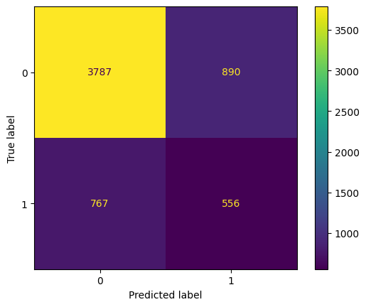
Decision trees
Model Training from sklearn.tree import DecisionTreeClassifier modelDT = DecisionTreeClassifier() modelDT.fit(x_train, y_train) | Evaluation of Decision tree model Test accuracy: 0.7238
Hyperparameter tuning
param_grid_DT = {
'criterion': ['gini', 'entropy'],
'max_depth': [None, 5, 10, 15],
'min_samples_split': [2, 5, 10],
'min_samples_leaf': [1, 2, 4]
}
grid_search_DT = GridSearchCV(estimator=modelDT, param_grid=param_grid_DT, scoring='accuracy', cv=5)
grid_search_DT.fit(x_train, y_train)
Accuracy_score = 0.8243
Precision = 0.3702
Recall = 0.4062

Slide 8
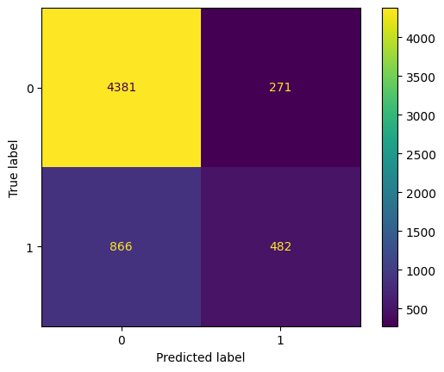
Random Forests
Model Training from sklearn.ensemble import RandomForestClassifier modelRF = RandomForestClassifier(n_estimators=100, random_state=42) modelRF.fit(x_train, y_train) | Evalutaiton of the model Accuracy score = 81.05
Precision: 0.6401
Recall:0.3575

Slide 9
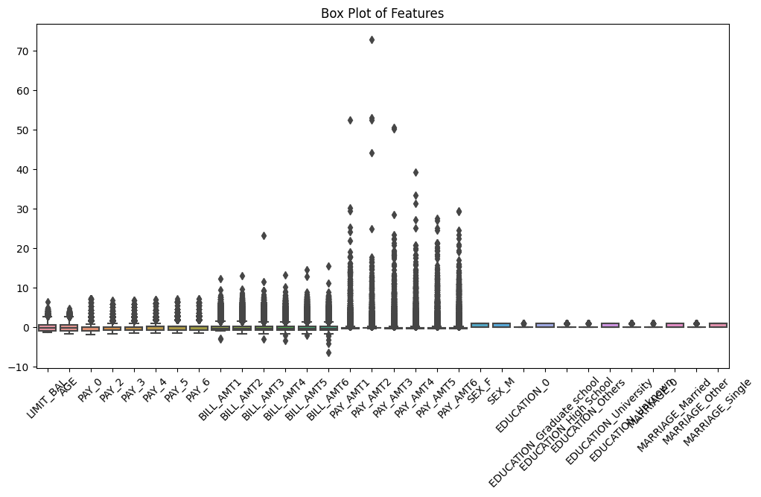
Outliers

Slide 10
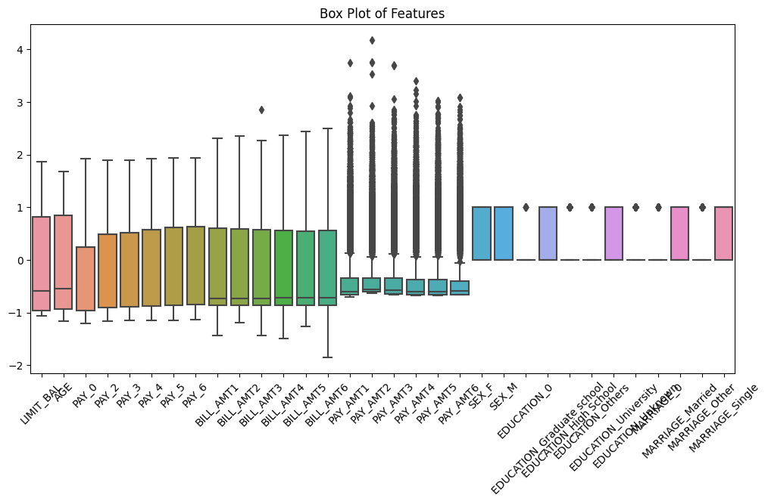
Transformation of Outliers

Slide 11
Classifier | Accuracy scores before transformation | Accuracy scores after transformation
Logistic Regression | 81.58 | 78.68
Decision Tree | 81.71 | 72.1
Random Forest | 81.05 | 81.63

Slide 12
Comparison of the models
Classifier | Accuracy | Precision | Recall
Logistic Regression | 81.58 | 0.7523 | 0.2454
Decision Tree | 81.71 | 0.3845 | 0.4202
Random Forest | 81.05 | 0.6401 | 0.3575

Slide 13
Conclusion
Using Recall as the main metric makes a lot of sense, because failing to detect defaulters could lead to more losses for the bank.
Decision trees provided us the best results giving us a recall of 42.02%.
Logistic Regression being the least accurate with a Recall of 24.54%

Slide 14
Future Work
Addressing the class imbalance issue can lead to improved results.
Hyperparameter tuning can be done such that it improves Recall value.
Given the high dimensionality of the data, implementing feature selection techniques can contribute to more effective modeling.

